Slide 1


Subhadip Samanta
IIFT Delhi
4.4 3.7

Slide 2





ABOUT MEESHO:
Meesho is an Indian-origin social commerce platform .It enables small businesses and individuals to start their online stores via social channels such as WhatsApp, Facebook, Instagram .
In June 2019, Meesho became India’s first
start-up to receive investment from
Facebook
Meesho raised
$125 million in Series D round led by Naspers
2 million sellers registered
80 percent of those are women 10 million resellers
4.4
Play Store
PROBLEM STATEMENT:
It is observed that 60% users (i.e., resellers) leave the platform after the first 7 days of doing their first sale.
OUR GOAL:
To enable the resellers to sell more and to suggest new big features that can be added which will help
increase selling via Meesho

Slide 3



ROADMAP:
USER
PERSONA
JOURNEY
MAPPING
PAIN
POINTS
SOLUTIONS
ANALYSIS
METRICS
IMPACTED
USER PERSONAS:
Naman, Student
23 year old lives in Kota
Due to COVID-19 lockdown Naman is stuck at home and looking to earn money while staying at Home.
Naman has a very big contacts circle and is highly active on many groups on Whatsapp, Facebook.
Ankita, Teacher
35 years old lives in Meerut, a mother of two.
Using Meesho from past 6- months and making decent earnings
Ankita is always in dilemma about finding the perfect product for her customers.
Shalini, Housewife
28 years old lives in Jaipur,
Want to start something
independently
Meesho for her seemed a perfect match

Slide 4





RESELLER’S JOURNEY:
Ankita
Finally, I’m done with my household work and have sent my 2 kids to School
I am now ready to wear my micro- entrepreneurship hat and to engage with my Customers by sharing great products and earn money.
Time to open the MEESHO app on the smartphone
MOODS:
Joy
Vigilant
Worried
Worried
Grief
OPEN’S MEESHO APP
PRODUCT DISCOVERY & SELECTION
BEFORE SHARING
AFTER SHARING
ORDER PLACEMENT
“What do I share today?”
“As there is no guidance I have to spend more time until I found something worth sharing”
I have decided the Product but is this product even Trending or Latest launched?
I hope the Product remains in stock till the time the customer agrees to the deal.
Hope that the Product quality is reliable with respect to the price.

Slide 5
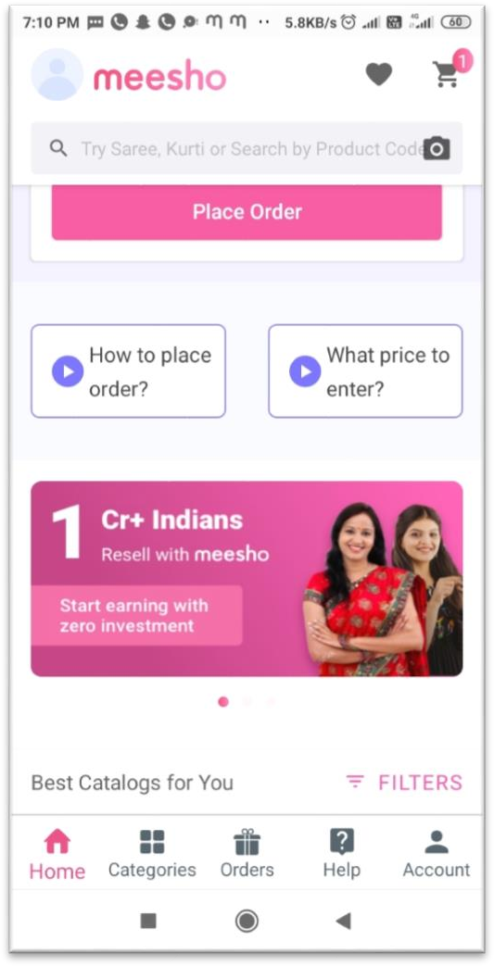
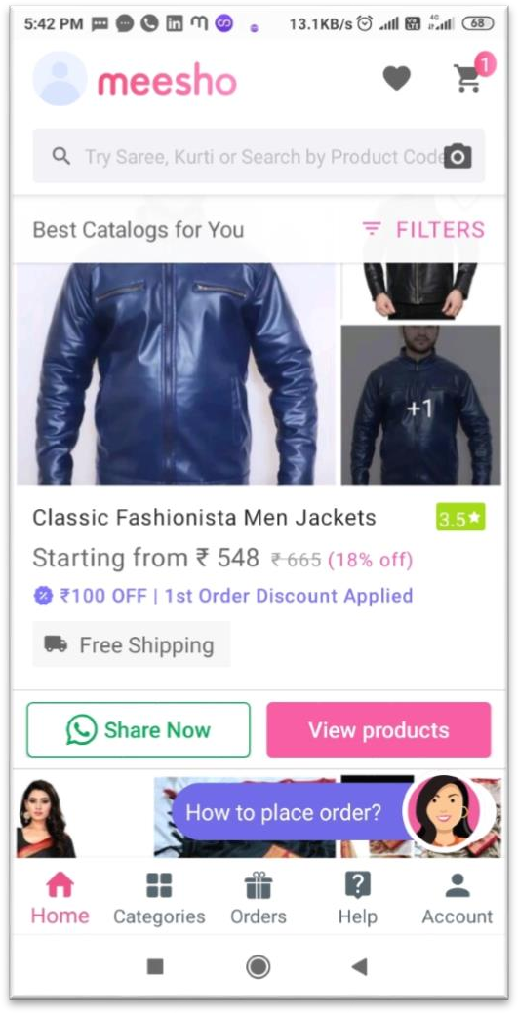
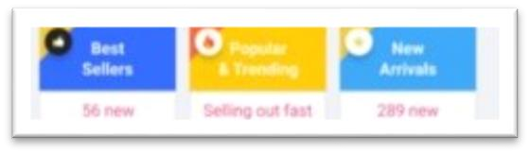

PAIN POINTS:
SOLUTIONS:
2.
When I open the app I don’t get any information about the products which are trending or are recently Launched there is no feature to guide regarding the same
1.
These solutions are proposed in order to improve the experience for the current resellers like Ankita.
Metrics: Shares/User
340+ Resellers in 4 Days!
Ankita
Product Sold Text
Will drive more Resellers. Approximate Share Count
Builds trust in the Platform as other users like her have shared it.
3645+ Shares
Quick Links to drive traffic to Trending Categories Here it improves discovery of trending Products amongst the Resellers, enabling them to rely upon it as the current Product is currently trending in the market..
The Catalogue doesn’t give information about whether the product is trending/newly Launched

Slide 6
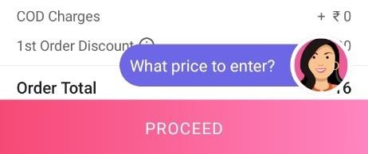
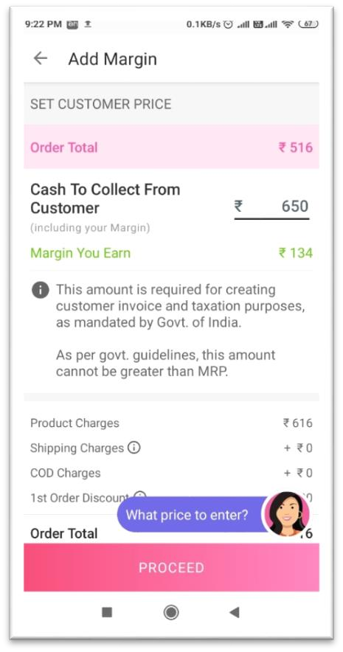
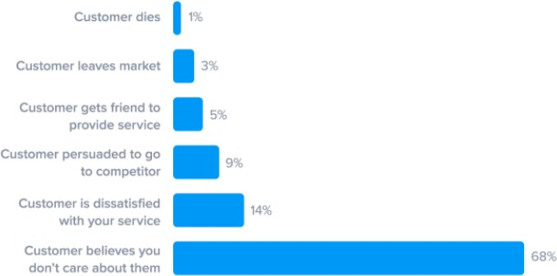
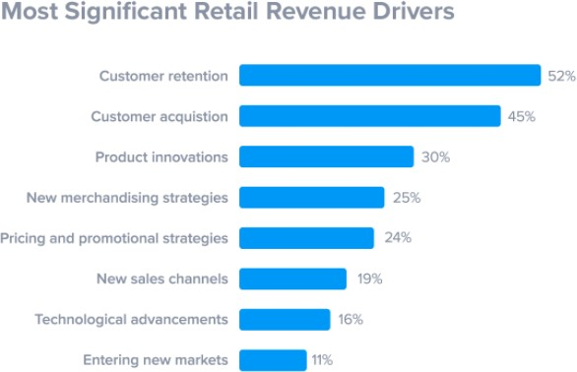
GOAL: Increasing Retention of Resellers after first Sale!
NEW FEATURE 1: COMEBACK AGAIN!
Value Proposition to User:
This will motivate Resellers to sell more as they will get additional commissions for executing the same.
This will not only increase the retention but also will contribute in increasing the acquisition of Users.
Features:
After Selling the Product, if the User sells a product in next 7 days they’ll earn an additional commission on that order
Insights:
According to SuperOffice , a Customer leaves a company when, Customer starts to think that Company don’t care about them after FTUE.
Value Proposition to
MEESHO:
Increased Retention
Increased Acquisition
Increased Revenue
Decreased Bounce Off
Rate
Congratulations on the Order!
Get 10% extra on the next order placed within
7days!
At the time of Order confirmation, Virtual Assistant pops up and displays the following message
Metrics to Consider:
DAU/MAU
Orders Placed/Seven Days/User
ARPU

Slide 7
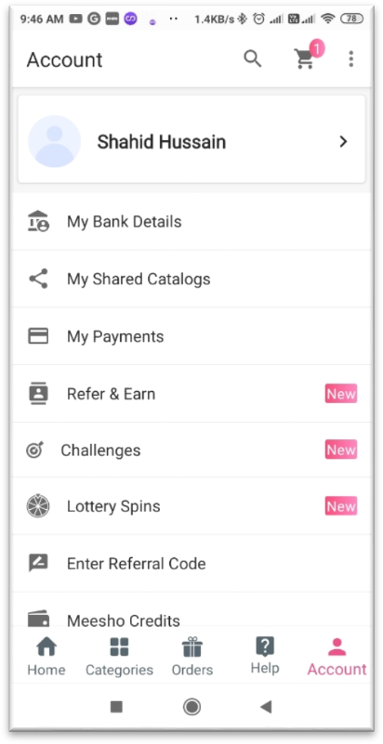
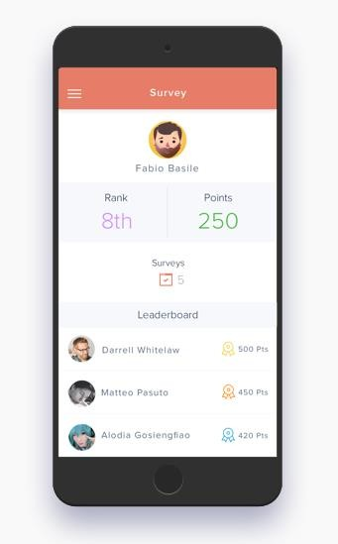



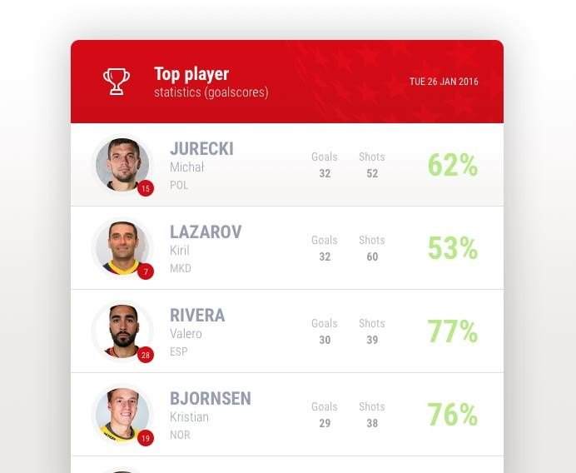
NEW FEARURE 2: Gamification/Team Leaderboards!
Features:
City wise, State wise Reseller Leader boards to enable the resellers to sell more in order to climb to the top and earn additional rewards.
Insights:
Not only do these leaderboards encourage healthy competition that leads to improved performance, but they also reduce stress.(Spinify)
Value Proposition to User:
This will motivate Resellers to sell more as they will get additional commissions for executing the same.
When resellers have a clear way of tracking how far they’ve come, and when their results seem more tangible, they’re more likely to feel satisfied with their Sales..
User can toggle between City and State Leaderboards
Regular Prompts
from assistant
Value Proposition to
MEESHO:
Leaderboards
Ko | ta | Rajas | than
Increased Retention
Increased Acquisition
Increased Sales
Increased Revenue
Decreased Bounce Off Rate
Leaderboards
Shahid Hussain
You’re Just few Points away from 1st Position!
A Tentative metric for Leaderboard Points calculation.
Sales Shares
Metrics to Consider:
DAU/MAU
Orders Placed/Seven Days/User

Slide 8
MEASURING THE SUCCESS OF SOLUTIONS:
We will use commonly used metrics from frameworks used in the industry like AARRR and HEART that are
relevant to the solution. The following are reporting metrics .
METRIC HEART | GOALS | SIGNALS | METRICS
HAPPINESS | User Satisfaction | User reviews and Ratings from Customer support | NPS, Average App rating
ENGAGEMENT | User Selling the Catalogues | Total number of sales and Time spent on the App | Total Revenue per user, Average Sales per Month
ADOPTION | User Onboarding | Number of App downloads, New Users, FTUE | Average Catalogues Shared, Number of reviews of resellers
RETENTION | User Loyalty | Recurring Resellers | Monthly Retention Rate, Number of items Sold by same Reseller
TASK SUCCESS | User Goal Completion | User Analytics and User Studies | Number of items Sold, Number of Points Earned

Slide 9
METRICS WRONGLY IMPACTED:
1. Bounce rate must be analysed per page/feature- wise, looking at user journeys, to understand if a particular feature is experiencing maximum bounce rate, it should be improved accordingly.
4. LTV:CAC Ratio : This is to understand how much company is spending to maximise growth and revenue, on acquiring customer. If it’s low, company needs to evaluate to cut down costs on customer acquisition
2. Inefficient implementation of the feature could cause distrust in users, App reviews/ratings and Weekly Active users can be tracked.
5. Churn Rate : If churn rate is going up, MEESO must analyse what kind of users they are losing. As per their past trends, the users must be offered customized deals/discounts through mails or notifications (in case the app is still installed), to bring them back
3. Monthly Revenue : If the Cumulative Revenue is going down, per feature revenue must be considered to see which feature is doing well and which is not.

Slide 10
THANK YOU!

